Slide 1



What's next

Slide 2
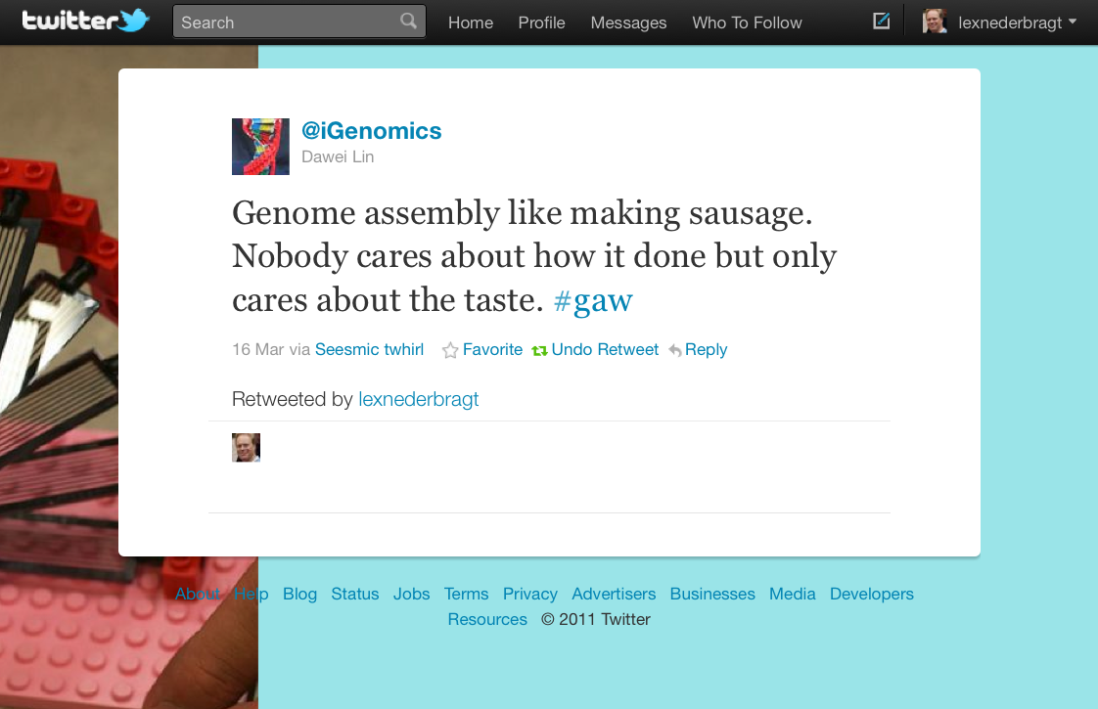

Slide 3
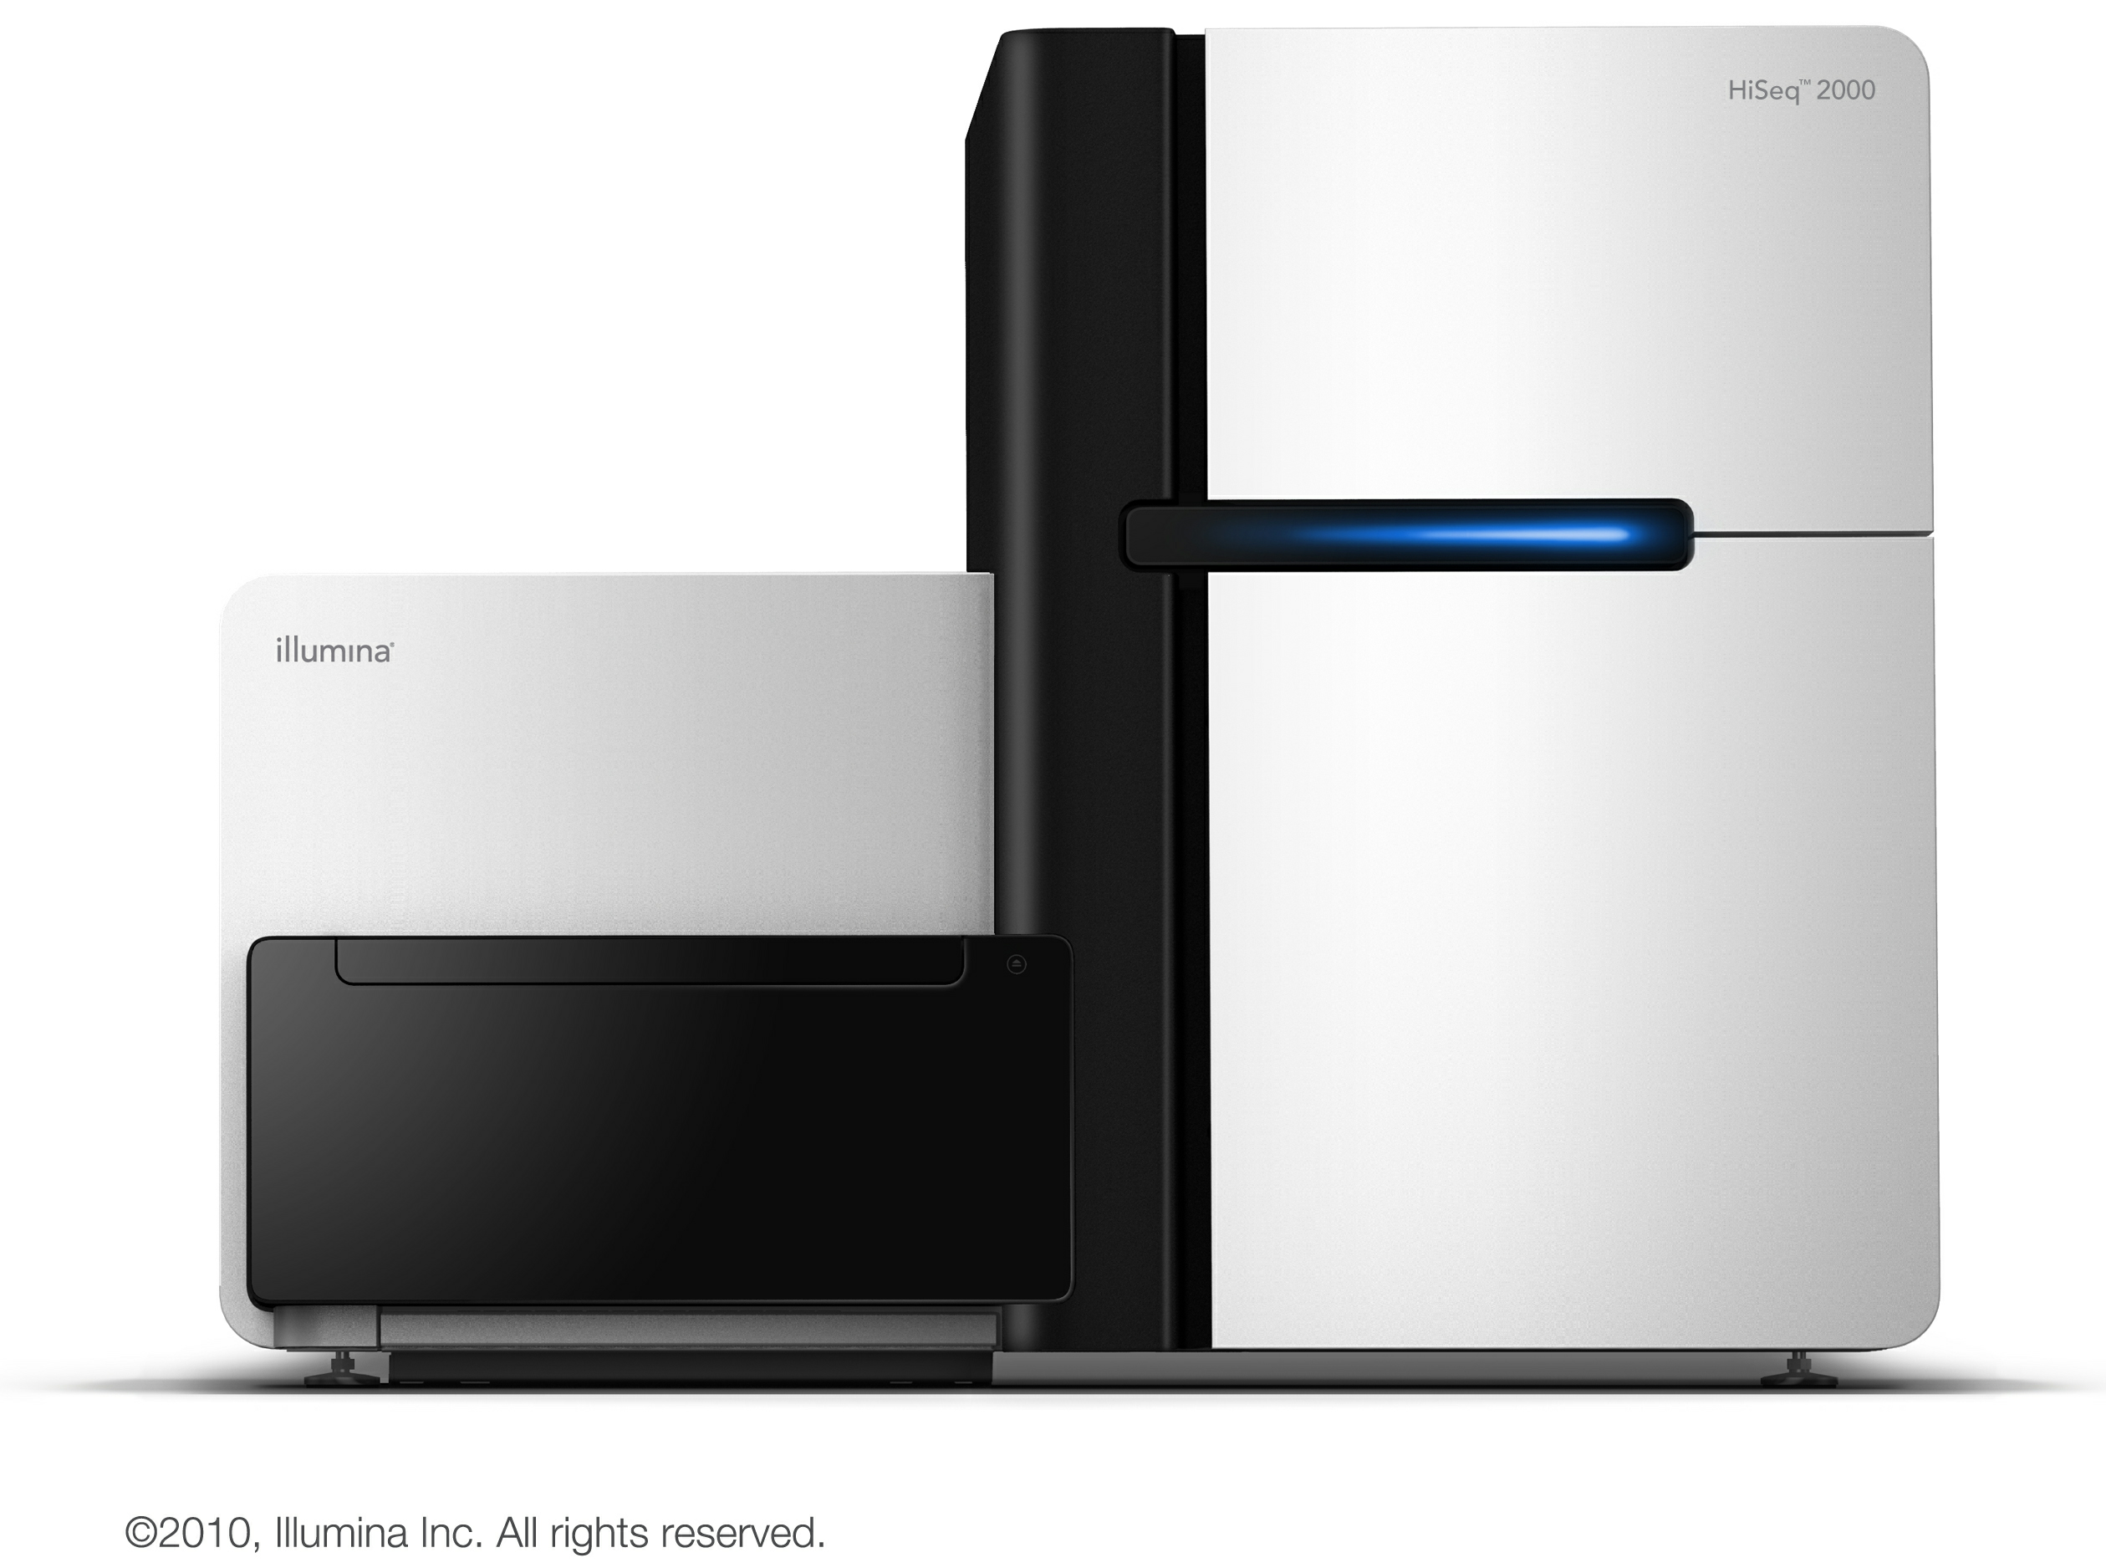
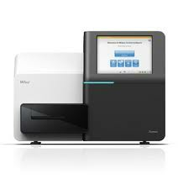
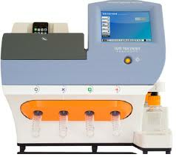
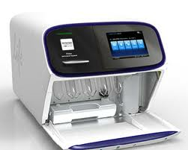
Announced upgrades
HiSeq 2000
2x150 bp?
HiSeq 2500
Rapid run mode 27 hrs
2x150 bp, 90 Gbp
2x 250 bp reads
8.5 Gbp
400 bp reads
Proton from Ion Torrent
Fall 2012: 10 Gb on Proton I chip, 400 bp
2013: 4 x more wells on Proton II chip

Slide 4
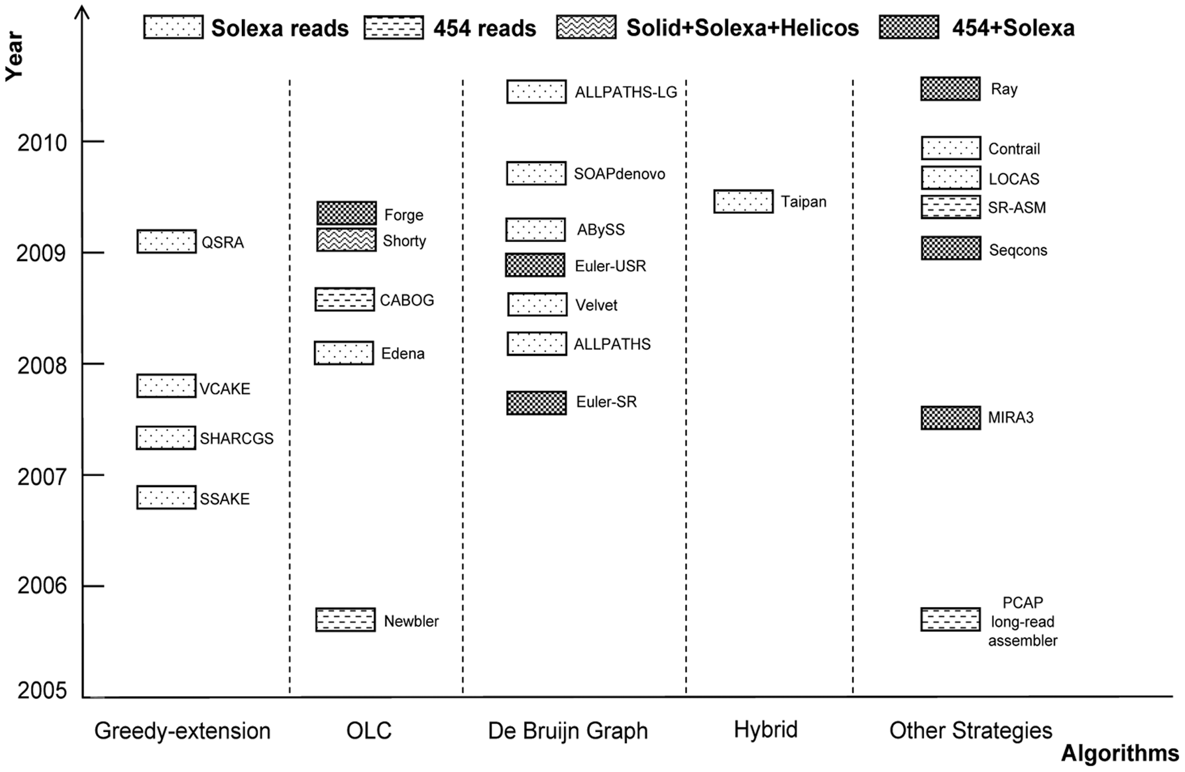
Many programs to choose from
Celera
Zhang et al. PLoSOne 2011

Slide 5
Assembly programs
Celera
Zhang et al. PLoSOne 2011

Slide 6
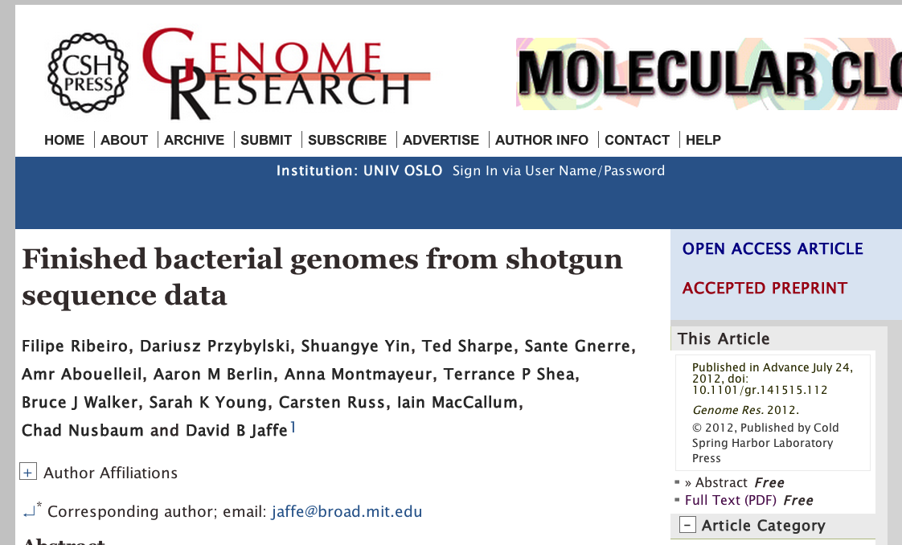

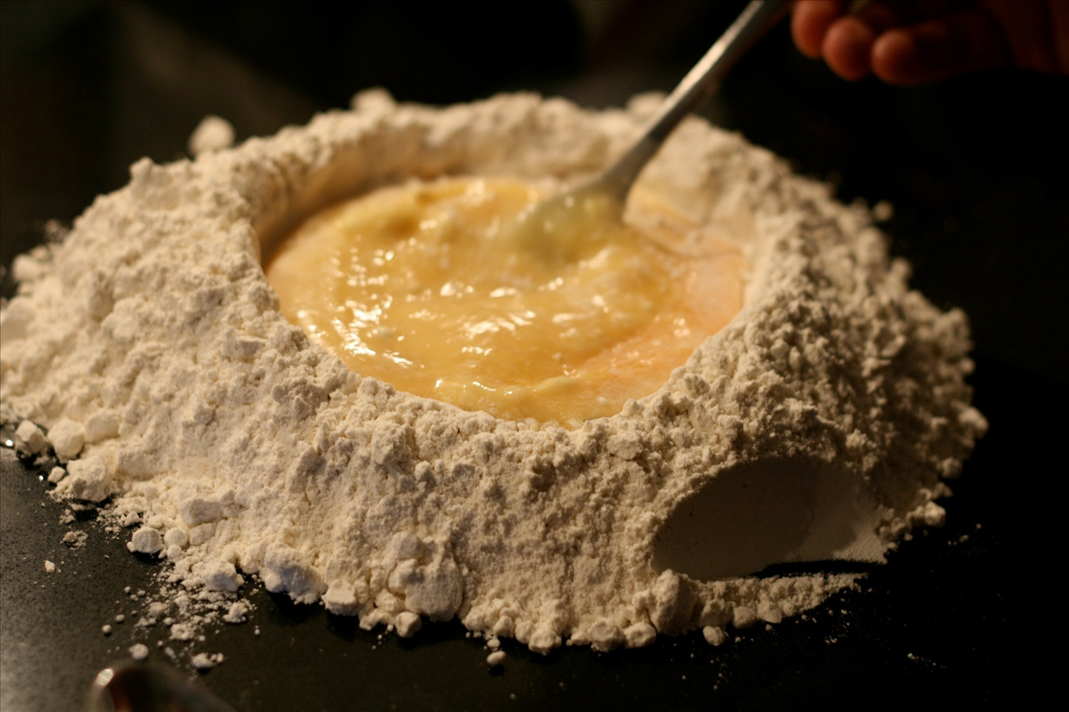
Allpaths_LG
Broad Institute
Need a special recipe
for sequencing

Slide 7
Improving the assembly
Stand-alone scaffolders
SSPACE (BaseClear)
Bambus
Stand-alone gap-closers
SoapDeNovo
GapFiller (BaseClear)

Slide 8

Assemblathon
Assembly competition
Eukaryotes
first one: simulated data
current one: real data
http://assemblathon.org/

Slide 9
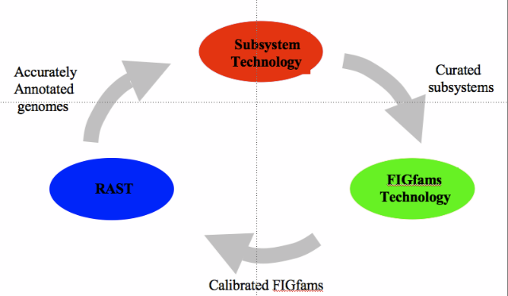
Annotation
RAST
http://www.theseed.org/

Slide 10
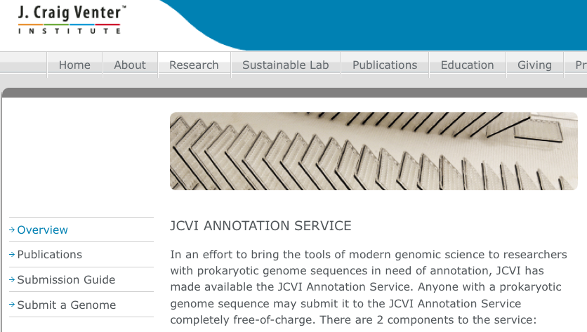
Annotation
JCVI
http://www.jcvi.org/cms/research/projects/annotation-service/

Slide 11
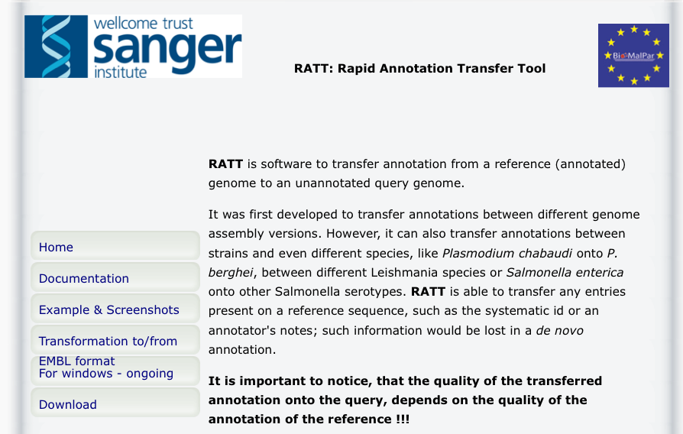
Annotation
RATT
http://ratt.sourceforge.net/

Slide 12
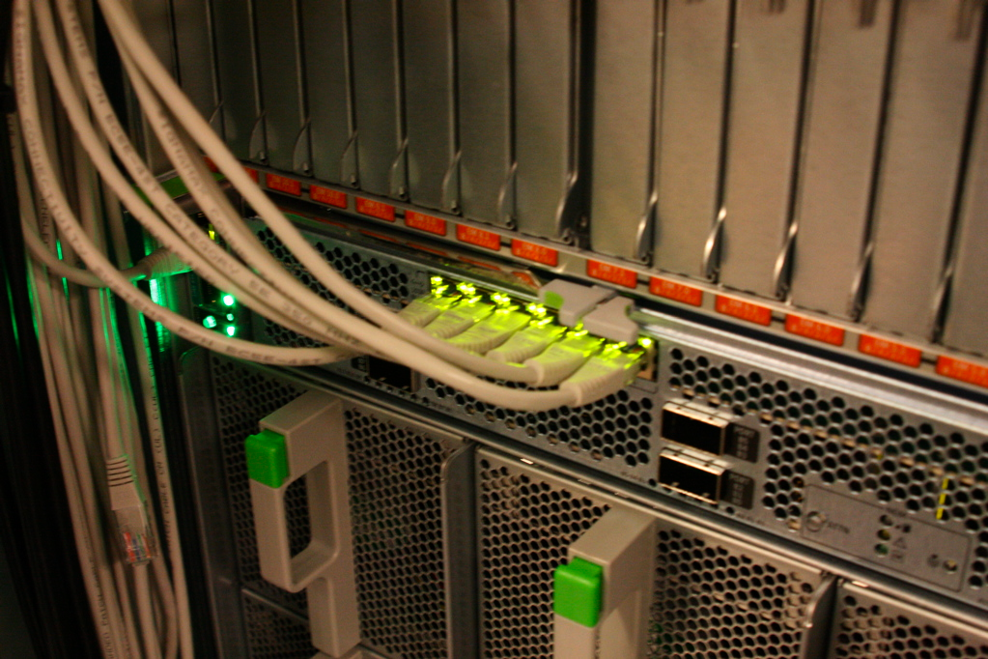
Large genomes
Challenges
Amount of data
Compute power
→ parallelization

Slide 13

Large genomes
Challenges
repeat content – can be up to 60%
heterozygosity
Check Assemblathon 2!
http://www.zazzle.com/

Slide 14
Getting started ‘at home’
Velvet
Install yourself
Newbler
Need linux
Abel cluster UiO
Apply for access and resources
http://www.uio.no/english/services/it/research/hpc/abel/help/access/

